Slide 1
Insertion Sort is O(nlogn)
Michael A. Bender, Martìn Farach-Colton and Miguel A. Mosteiro
Theory of Computing Systems, Vol. 39, pp. 391-397, 2006
Presenter: Yung-Hsing Peng
Date: Nov. 28, 2007

Slide 2
Abstract
Traditional INSERTION SORT runs in O(n²) time because each insertion takes O(n) time. When people run INSERTION SORT in the physical world, they leave gaps between items to accelerate insertions. Gaps help in computers as well. This paper shows that GAPPED INSERTION SORT has insertion times of O(logn) with high probability, yielding a total running time of O(nlogn) with high probability.

Slide 3
Traditional Insertion Sort
8 | 2 | 1 | 7 | 6
2 | 8 | 1 | 7 | 6
2 | 8 | 1 | 7 | 6
2 | 1 | 8 | 7 | 6
2 | 1 | 8 | 7 | 6
1 | 2 | 8 | 7 | 6
1 | 2 | 8 | 7 | 6
1 | 2 | 7 | 8 | 6
1 | 2 | 7 | 8 | 6
1 | 2 | 7 | 6 | 8
1 | 2 | 7 | 6 | 8
1 | 2 | 6 | 7 | 8
1 | 2 | 6 | 7 | 8
Phase I ends
Phase II ends
Phase III ends
Phase IV ends
Finish!
Total 6 shifts
At this time, insertion of ‘5’ yields another 3 shifts.

Slide 4
The Idea of GAPPED INSERTION SORT
Additional εn gaps are considered
Required space: (1+ε)n
When gaps are almost used up, the sorting array needs rebalancing.

Slide 5
GAPPED INSERTION SORT with ε= 0.125
Sorting array with gaps
intercalated
Initialize
8 |  | Size = 1.125
 | 8 |  | Size = 2.25
2 | 8
 | 2 |  | 8 |  | Size = 4.5
1 | 2 |  | 8
1 | 2 | 7 | 8
 | 1 |  | 2 |  | 7 |  | 8 |  | Size = 9
 | 1 |  | 2 | 6 | 7 |  | 8
 | 1 |  | 2 | 6 | 7 |  | 8
2 1 7 6
Rebalance
2 1 7 6
Insert 2
1 7 6
Rebalance
1 7 6
Insert 1
7 6
Insert 7
6
Rebalance
6
Insert 6
Finish!
Total 0 shifts
At this time, insertion of ‘5’ only yields another 2 shifts.

Slide 6
About GAPPED INSERTION SORT
How to locate the proper position of each insertion, when there are some gaps?
When to perform rebalancing?
How to analyze its time complexity with the spreading factor ε?

Slide 7
Searching in the Sorting Array
Note that the gaps are evenly distributed in the sorting array. Binary search is still applicable.
For ε≥ 1, it takes O(ε) time to accomplish the comparison. For any 0 <ε< 1, the comparison takes O(1) time.
For constant ε, it takes O(logn) time to locate the position for each insertion. (The sorting array is of size (1+ε)n)

Slide 8
Timing for Rebalancing
Rebalance the sorting array whenever there are 2^{k} elements inserted.
The overall time complexity for rebalancing can be written as 4+8+16…+2n = O(n)
The overall time for searching and rebalancing is bounded by O(nlogn) + O(n) = O(nlogn)
→ The bottleneck consists in the number of shifts!

Slide 9
Some Tips
GAPPED INSERTION SORT proceeds in logn rounds.
Round i ends when element 2^{i} is inserted. When each round begins, the sorting array is rebalanced.
Before the rebalance, the 2^{i} elements are in the first (1+ε)2^{i} positions. A rebalance moves them into the first (2+2ε)2^{i} positions, spreading the elements as evenly as possible.

Slide 10
Bender’s Analysis
Consider insertions in each round i
Gaps
Contiguous elements
When round i begins, we create a balanced sorting array of size (2+2ε)2^{i-1} (with 2^{i-1} = m elements, called support elements)
In this round, we have 2^{i-1} = m intercalated elements to insert
(2+ε)clogm contiguous elements
At the end of this round (before rebalancing), Bender shows that for any set C of (2+ε)clogm contiguous elements, it has at least clogm support elements and clogm elements with high probability.

Slide 11
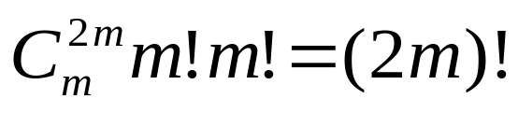
Bender’s Analysis
In each round, we have m support elements and m intercalated element. Since we have 2m numbers, there are totally (2m)! permutations as possible inputs.
Given 2m numbers, there are (2m)! ways to form m support elements and m intercalated elements.
2m numbers
We can adopt this model to consider every possible input.
m support
m intercalate

Slide 12
Bender’s Analysis
In this model, let p_{k} be the probability that the kth number belongs to the set of support element.
The kth number
2m–k+1numbers
p_{k} =
(m – s_{k}) / (2m – k +1)
?
?
s_{k} support
k–s_{k} intercalate

Slide 13
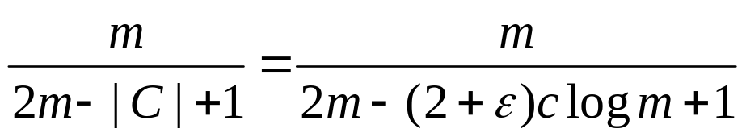
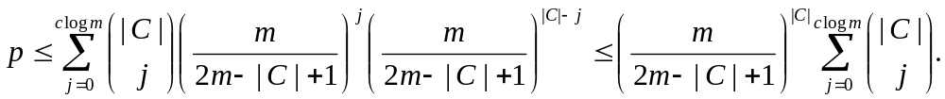
Bender’s Analysis
Let C be an arbitrary set of (2+ε)clogm contiguous elements in the sorting array at the end of each round (before rebalancing). The probability that a given element in C is a support element is at most
Let p be the probability that there are at most clogm support elements in the set C. Then,

Slide 14
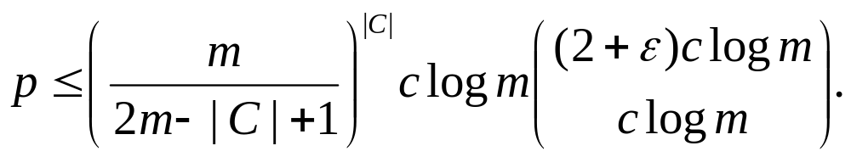
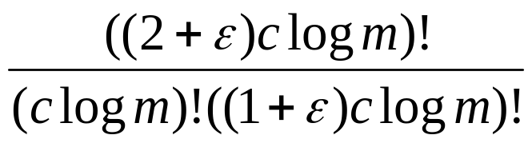
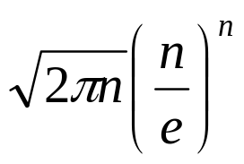
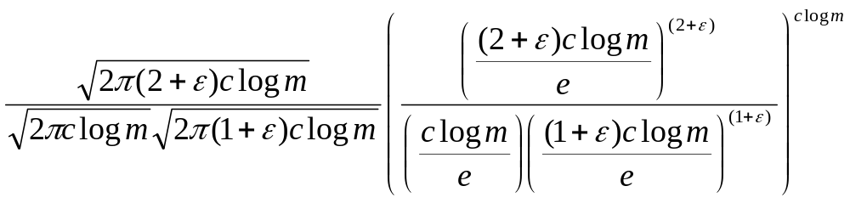
Bender’s Analysis
Bounding the summation by the largest term, we obtain
Stirling’s approximation:
n! ≈

Slide 15
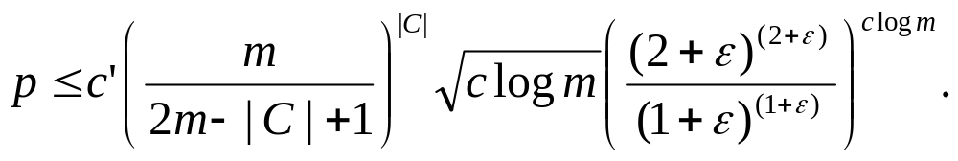
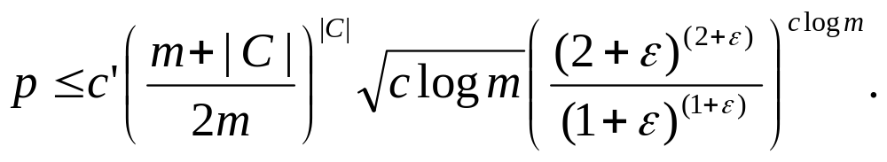
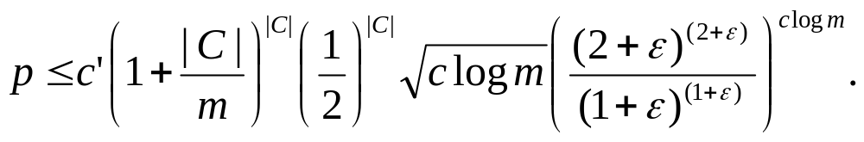
Bender’s Analysis
According to previous page, for some constant c’, we have
Manipulating on the first term, we have

Slide 16
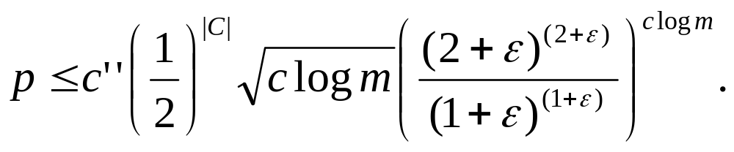
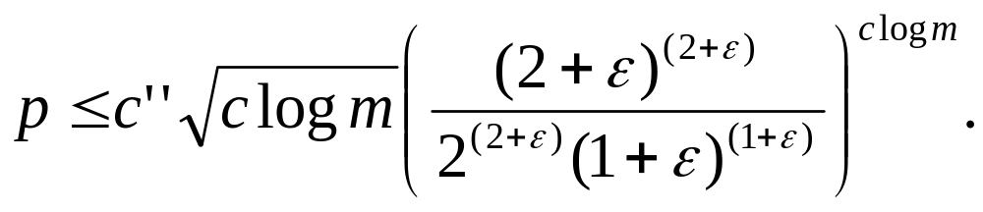
Bender’s Analysis
Because |C| << m, the first term becomes 1+o(1) and we have
Substituting |C| with (2+ε)m, we have
Note that p is the probability that there are at most clogm support elements in the set C of (2+ε)clogm contiguous elements.
This means there is a high probability (1–p) that C contains more than clogm support elements.

Slide 17
Bender’s Analysis
With the same idea, there is also a high probability that C contains more than clogm intercalated elements.
Theorem: In any set C of (2+ε)clogm contiguous elements, there are at least clogm support elements and at least clogm intercalated elements with high probability.
Recall that when each round begins, we store each clogm support elements with (2+2ε)clogm space (rebalance).
If there are at most (1+ε)clogm intercalated elements to insert, then we have εclgom gaps remain unused.
With high probability no insertion moves more than (2+ε)clogm elements.

Slide 18
Conclusion
Searching: O(nlogn) time
Rebalancing: O(n) time
Insertion: O(nlogn) time
GAPPED INSERTION SORT: O(nlogn) time with high probability
Compared with previous results, Bender’s analysis is relatively simple because it only uses elementary methods.

